Slide 1
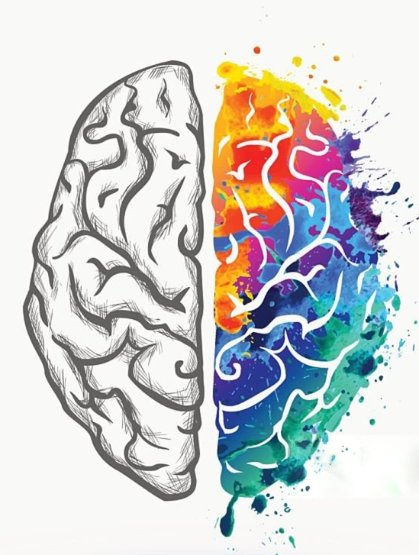
Hormones
Chad Williams
University of Victoria

Slide 2
Lecture Outline
Principles of Hormones
The Pituitary Gland
Hormone Systems

Slide 3
Lecture Outline
Principles of Hormones
The Pituitary Gland
Hormone Systems

Slide 4
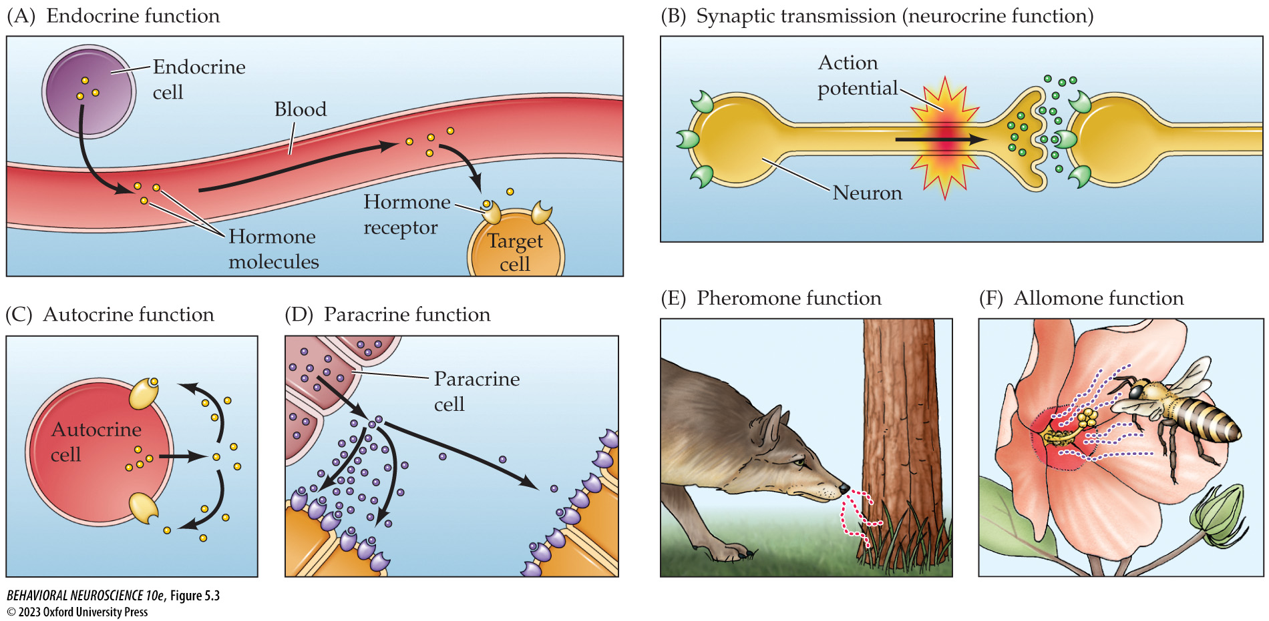
Chemical Communication
Types of Communication
Endocrine: A hormone is released into the bloodstream to act on target tissues
Synaptic/Neurocrine: Chemical release and diffusion across a synapse.
Autocrine: Released chemical acts on the releasing cell
Paracrine: The released chemical diffuses to nearby target cells
Pheromone: Hormones used to communicate between individuals of the same species
Allomone: Chemicals released by one species to affect the behavior of another species.

Slide 5
Hormones
Principles of Hormones
Hormones are released into the bloodstream and have distant targets
Act in a gradual fashion
Often can take days, weeks, or years
Act by changing the probability or intensity of a behaviour
Not by turning a behaviour on/off
The relationship between behaviour and hormones is reciprocal
Hormones affect behaviour and behaviour affects hormones

Slide 6
Hormones
Principles of Hormones
A hormone may have multiple effects, and one behavior can be affected by several hormones
Hormones often have a pulsatile secretion pattern—in bursts
Some hormones are controlled by circadian clocks in the brain
Hormones can interact with other hormones and change their effects
Hormones can only affect cells with a receptor protein for that hormone

Slide 7
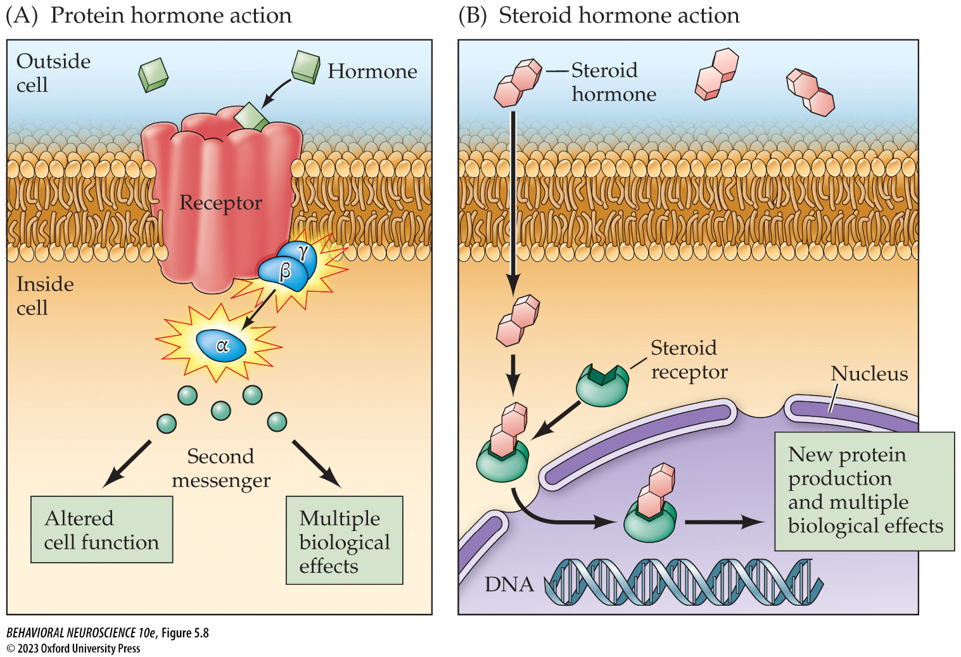
Hormones
Classes of Hormones
Distinguished by chemical structure
Peptide Hormones: Proteins
Steroid Hormones: Lipids
Amine Hormones: Amino acid derivatives

Slide 8
Hormones
Peptide Hormones
Proteins (amino acid chains) that are packaged in vesicles and released through exocytosis, like neurotransmitters
Binding: Metabotropic receptors on cell surface
Timeline: Acts in seconds to minutes, short lived
Function: Typically modifies enzyme activity, ion channel activity, and cellular excitability
Examples: Insulin, oxytocin, vasopressin

Slide 9
Hormones
Steroid Hormones
Lipids that are synthesized on demand
Can freely move across membranes
Binding: Intracellular cytoplasmic/nuclear receptors
Timeline: Acts in hours to days, long-lasting effects
Function: Regulates gene expression
Changes protein production within the cell
Examples: Cortisol, testosterone, estrogen

Slide 10
Hormones
Amine Hormones
Single amino acid derivatives
Catecholamines: Acts as peptide hormones
Examples: Epinephrine, norepinephrine
Thyroid Hormones: Acts as steroid hormones
Examples: Thyroid hormones

Slide 11
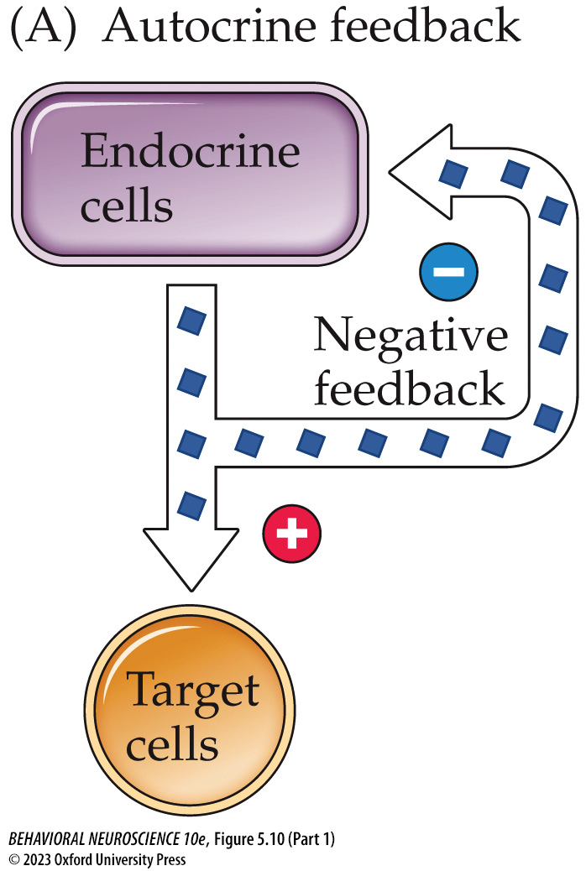
Hormone Regulation
Hormone Regulation: Hormone systems receive feedback to control their hormone production
Autocrine Feedback: Feedback from its own produced hormone

Slide 12
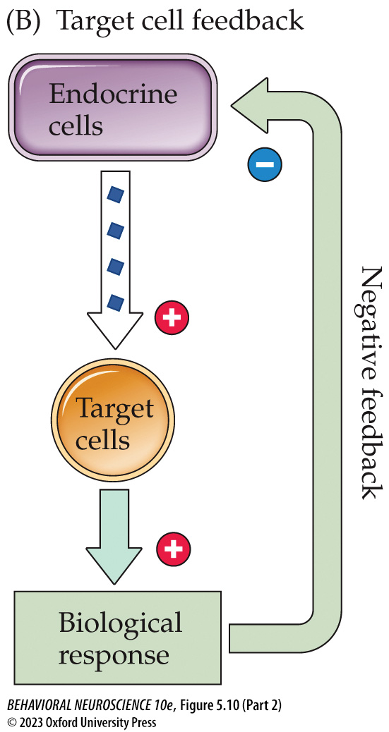
Hormone Regulation
Hormone Regulation
Target Cell Feedback: Feedback from the biological response of the target cell

Slide 13
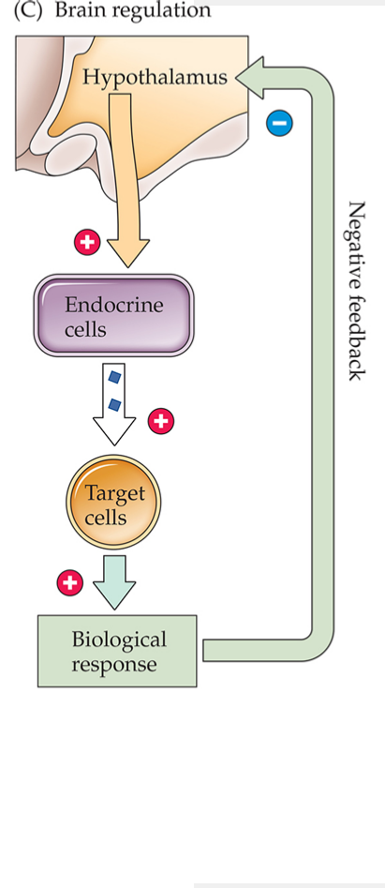
Hormone Regulation
Hormone Regulation
Brain Regulation: Feedback of target cell’s biological response is provided to a brain region that moderates the hormone system

Slide 14
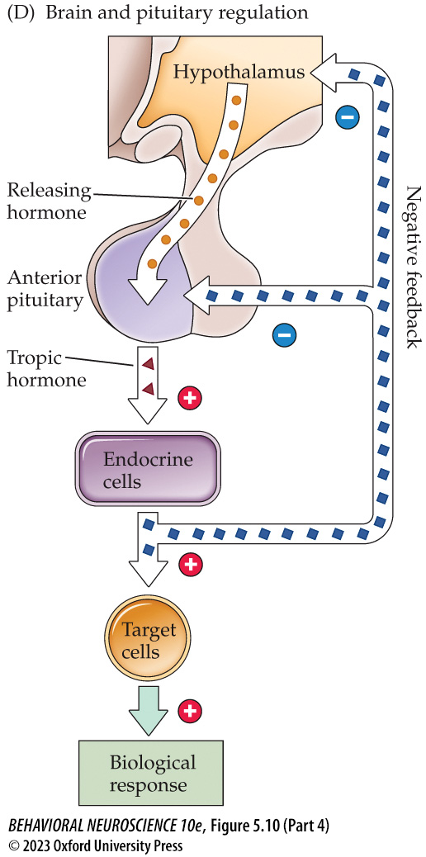
Hormone Regulation
Hormone Regulation
Brain and Pituitary Regulation: Feedback is provided to both a brain region (hypothalamus) and the pituitary gland that moderates the hormone system

Slide 15
Lecture Outline
Principles of Hormones
The Pituitary Gland
Hormone Systems

Slide 16
Structure | Produced Hormone(s) | Type of Hormone | General Function
Posterior Pituitary Gland | Vasopressin | Peptide hormone | Water retention and blood pressure regulation
Posterior Pituitary Gland | Oxytocin | Peptide hormone | Reproduction, parental bonding, and social behaviours

Slide 17
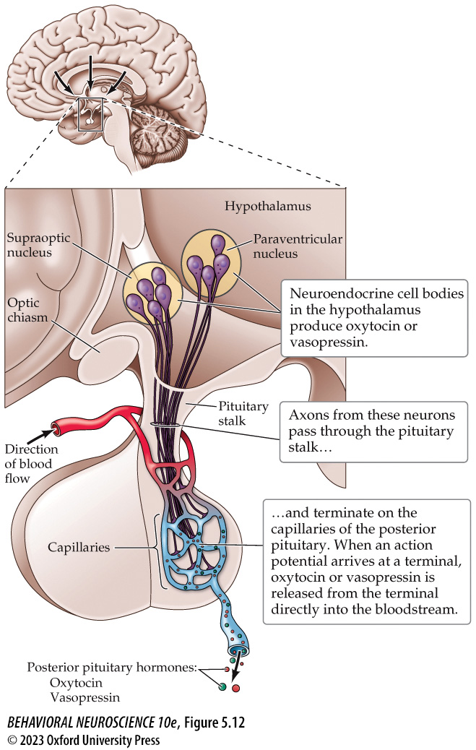
The Pituitary Gland
Pituitary Gland: Controls hormone release of other endocrine glands
Controlled by the hypothalamus
Anterior and posterior portions have different functions

Slide 18
The Pituitary Gland
Posterior Pituitary Gland: Site for the dissemination of vasopressin and oxytocin
Production and release: These hormones are produced within the hypothalamus and excreted into the bloodstream within this gland
The cell bodies are in the hypothalamus
Axons project into the posterior pituitary

Slide 19
The Pituitary Gland
Posterior Pituitary Gland
Vasopressin (Peptide hormone)
High concentration: Constricts blood vessels to help increase blood pressure
Triggered by low blood pressure
Ensures that vital organs (e.g., brain) receive sufficient oxygen and nutrients

Slide 20
The Pituitary Gland
Posterior Pituitary Gland
Vasopressin (Peptide hormone)
Low concentration: Preserves water by increasing water reabsorption in the kidneys, reducing urination
Triggered by hypertonicity, when bodily fluids are too concentrated
Prevents dehydration, which can lead to cell damage and neurological issues

Slide 21
The Pituitary Gland
Posterior Pituitary Gland:
Oxytocin (Peptide hormone)
Influences reproductive, parental, and social behaviours
Involved in one of the few positive feedback loops in the endocrine system

Slide 22
The Pituitary Gland
Posterior Pituitary Gland:
Oxytocin
Maternal: Contractions during childbirth and milk let-down
Triggered by internal (e.g., fetus movement) and external (e.g., baby crying) factors
Paternal: Promotes ejaculation
Triggered by sexual arousal

Slide 23
The Pituitary Gland
Posterior Pituitary Gland:
Oxytocin
Parental: Supports parent-infant bonding
Triggered by social interactions and physical contact
Social Bonding: Romantic attachment, trust, sexual arousal and orgasm
Triggered by physical touch (e.g., hugging)

Slide 24
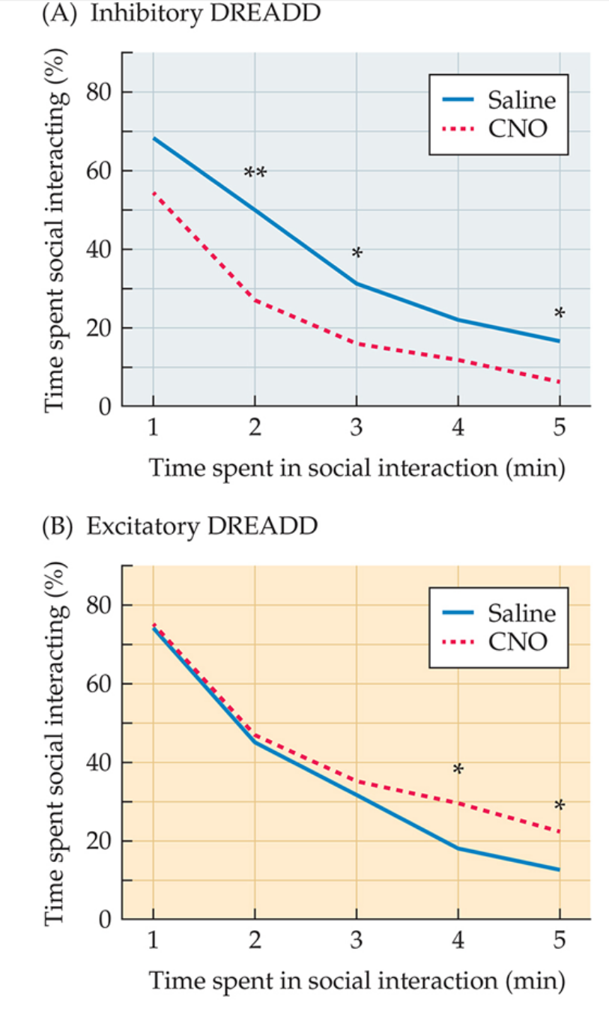
The Pituitary Gland
Tang et al., 2020
Research Question
Is the enhancement of communication through social touch in female rats mediated by parvocellular oxytocin neurons?
Method
Optogenetic tools were applied to selectively activate or inhibit specific OT neuron populations
Optogenetics: Control neurons using light
Rats were placed into a social interaction environment and observed in terms of the time spent interacting

Slide 25
The Pituitary Gland
Tang et al., 2020
Manipulation
Healthy controls (saline)
Inhibition of OT neurons (CNO)
Excitation of OT neurons (CNO)
Dependent Variable
The percentage of time spent interacting

Slide 26
The Pituitary Gland
Tang et al., 2020
Results
Inhibiting OT neurons reduced time interacting
Exciting OT neurons increased time interacting
Although to a lesser degree
Conclusion
Parvocellular OT neurons play a key role in the positive feedback loop
They are activated by physical touch, which leads to more OT, which in turn leads to more touch

Slide 27
Structure | Produced Hormone(s) | Type of Hormone | General Function
Posterior Pituitary Gland | Vasopressin | Peptide hormone | Water retention and blood pressure regulation
Posterior Pituitary Gland | Oxytocin | Peptide hormone | Reproduction, parental bonding, and social behaviours

Slide 28
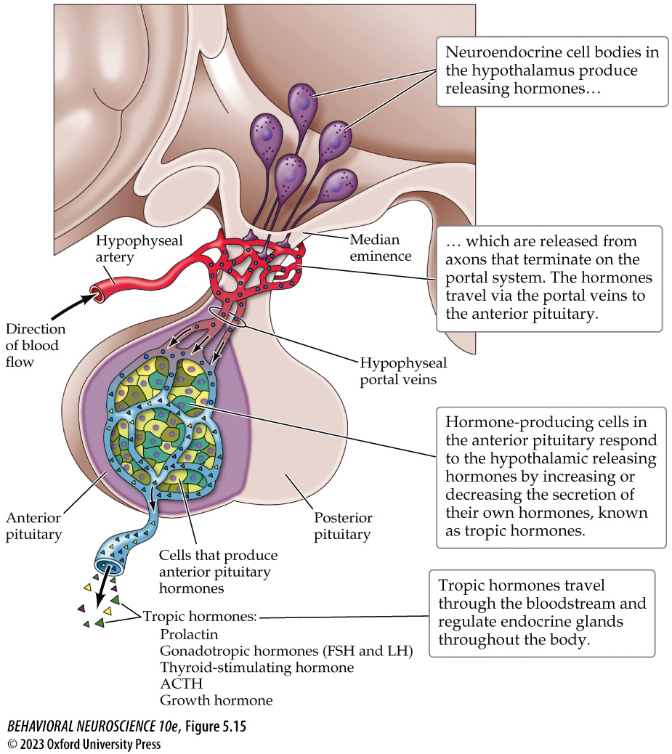
The Pituitary Gland
Anterior Pituitary Gland: Site of production and release of six tropic hormones
Production and release
Releasing hormones are produced in the hypothalamus and released into the hypothalamic bloodstream
Releasing hormones are mostly peptide hormones
These hormones travel directly to the anterior pituitary, where they stimulate the production and release of tropic hormones
Tropic hormones are mostly peptide hormones
Tropic hormones are then released into the bloodstream and travel throughout the body
Each tropic hormone targets specific glands and structures with different functions

Slide 29
Lecture Outline
Principles of Hormones
Behavioural Endocrionology
The Pituitary Gland
Hormone Systems

Slide 30
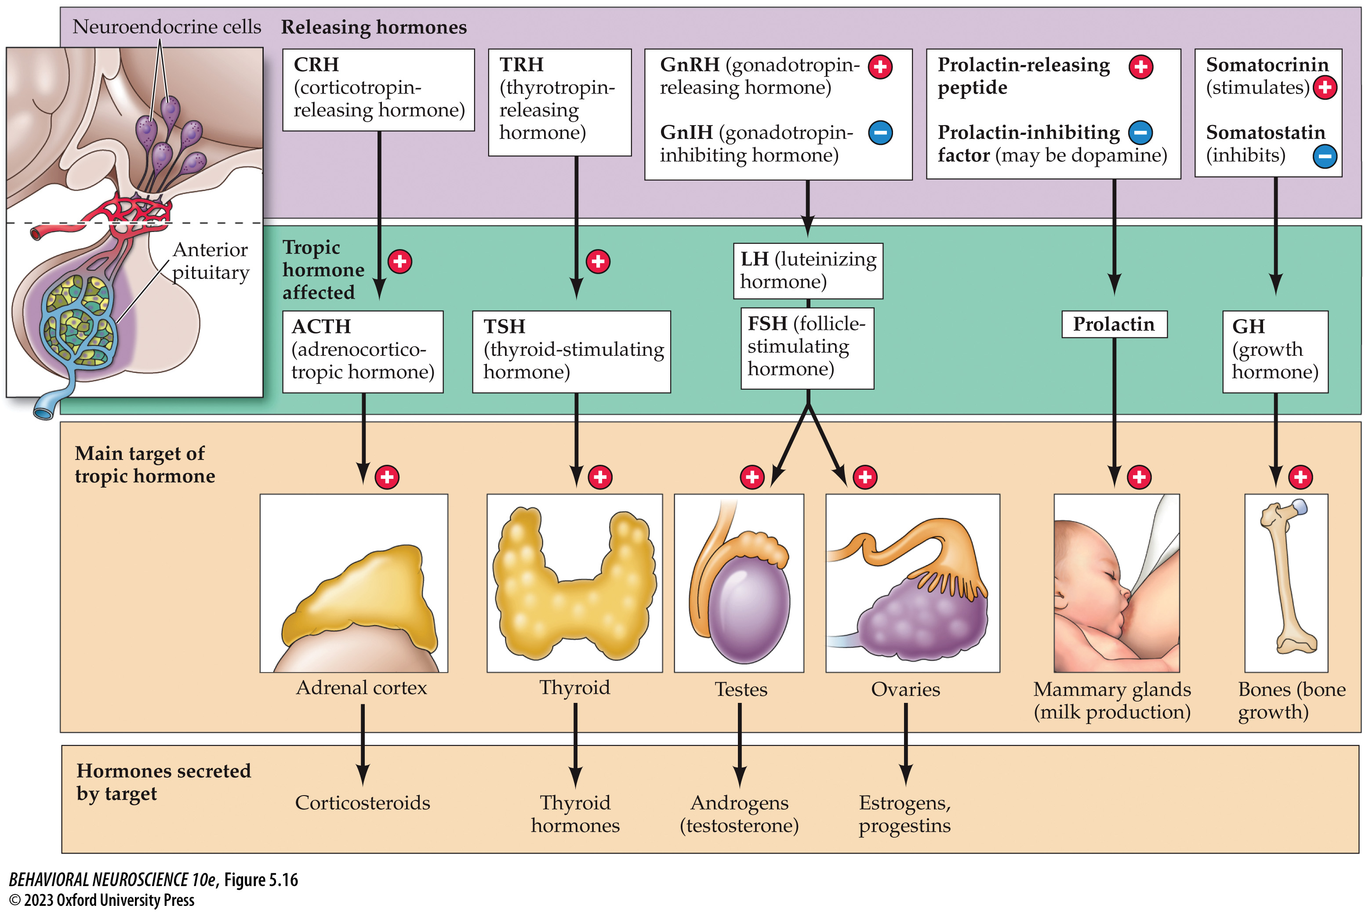

Slide 31
Structure | Produced Hormone(s) | Type of Hormone | General Function
Posterior Pituitary Gland | Vasopressin | Peptide hormone | Water retention and blood pressure regulation
Posterior Pituitary Gland | Oxytocin | Peptide hormone | Reproduction, parental bonding, and social behaviours
Adrenal Cortex | Glucocorticoids (e.g., cortisol), Mineralocorticoids (e.g., aldosterone) | Steroid hormones | Stress response, energy regulation, blood pressure and fluid balance
Adrenal Medulla | Epinephrine, Norepinephrine | Amine hormones | Fight-or-flight response
Thyroid Gland | Thyroid hormones (T3/T4) | Amine hormones | Regulation of metabolism, growth, development, and physiological activity
Testes | Testosterone | Steroid hormone | Sperm production, sexual development, reproductive behaviour
Ovaries | Estrogen, Progesterone | Steroid hormones | Egg maturation, reproductive function, pregnancy support
Mammary Glands | None | — | Lactation and breast development
Bones and Other Tissues | None | — | Growth and maintenance of cells and tissues
Pineal Gland | Melatonin | Amine hormone | Regulation of circadian and seasonal rhythms

Slide 32
Hormone Systems
Adrenal Gland: Releases steroid hormones
Contains both the adrenal cortex and the adrenal medulla
Function: Stress response

Slide 33
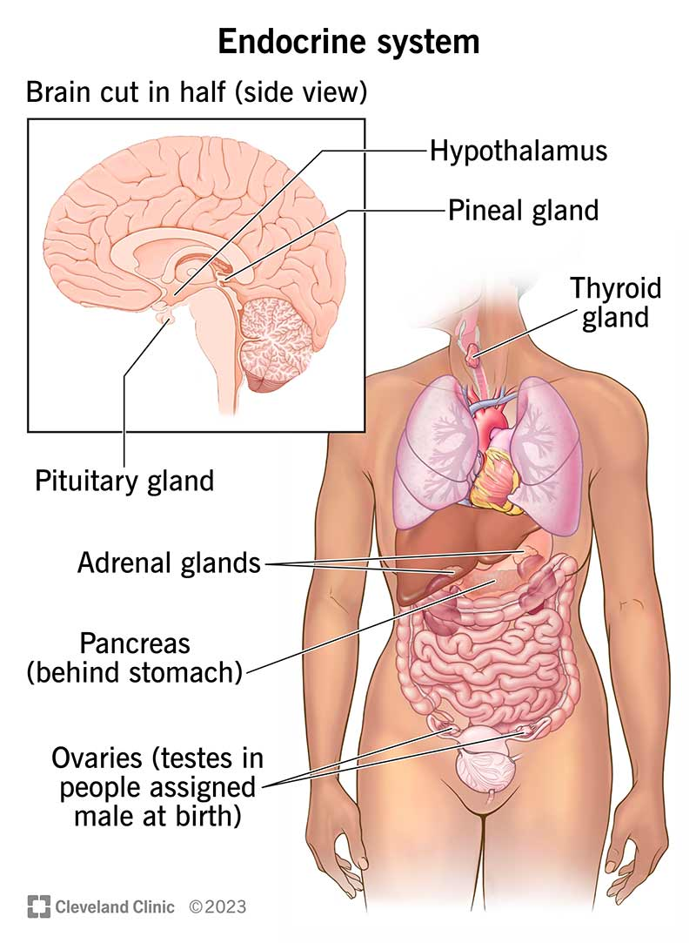
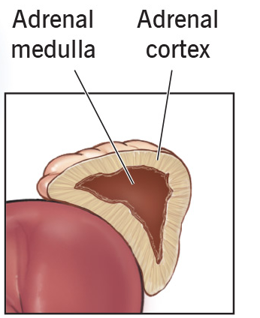
Hormone Systems
Adrenal Cortex
Hormones: Two classes of hormones, each with their own set of steroid hormones
Glucocorticoids & Mineralocorticoids
Glucocorticoids (e.g., cortisol)
Increase blood sugar and protein breakdown to provide energy
Suppress inflammation and immune responses to prevent tissue damage
Important as stress activates the immune system, increasing inflammation

Slide 34
Hormone Systems
Adrenal Cortex
Mineralocorticoids (e.g., aldosterone)
Promote sodium retention and reduce urine production
Help regulate blood pressure and fluid balance
These ensure organs receive sufficient oxygen and nutrients

Slide 35
Hormone Systems
Adrenal Medulla
Hormones: Epinephrine and Norepinephrine
Amine hormones
Function:
Fight-or-flight response
Raises heart rate and respiration rate
Not stimulated by the hypothalamus + pituitary gland

Slide 36
Hormone Systems
Thyroid Gland
Hormone: Thyroid hormones
Amine hormones
Function:
Regulates physiological processes including metabolism, heart rate, digestion, breathing, alertness, and reflexes
Essential for proper growth and development early in life
Important for brain development, including the formation of axons and dendrites
Thyroid hormone deficiency during development can cause intellectual disability

Slide 37
Hormone Systems
Testes
Hormone: Testosterone
Steroid hormone
Function:
Sperm production
Determines puberty and sexual development
Deepening of voice, hair growth, genital growth
Influences seasonal mating characteristics
E.g., antler development
Declines with old age
Positively linked to memory and attention in elderly
Associated with increased aggression and reduced cooperative behaviours in some contexts

Slide 38
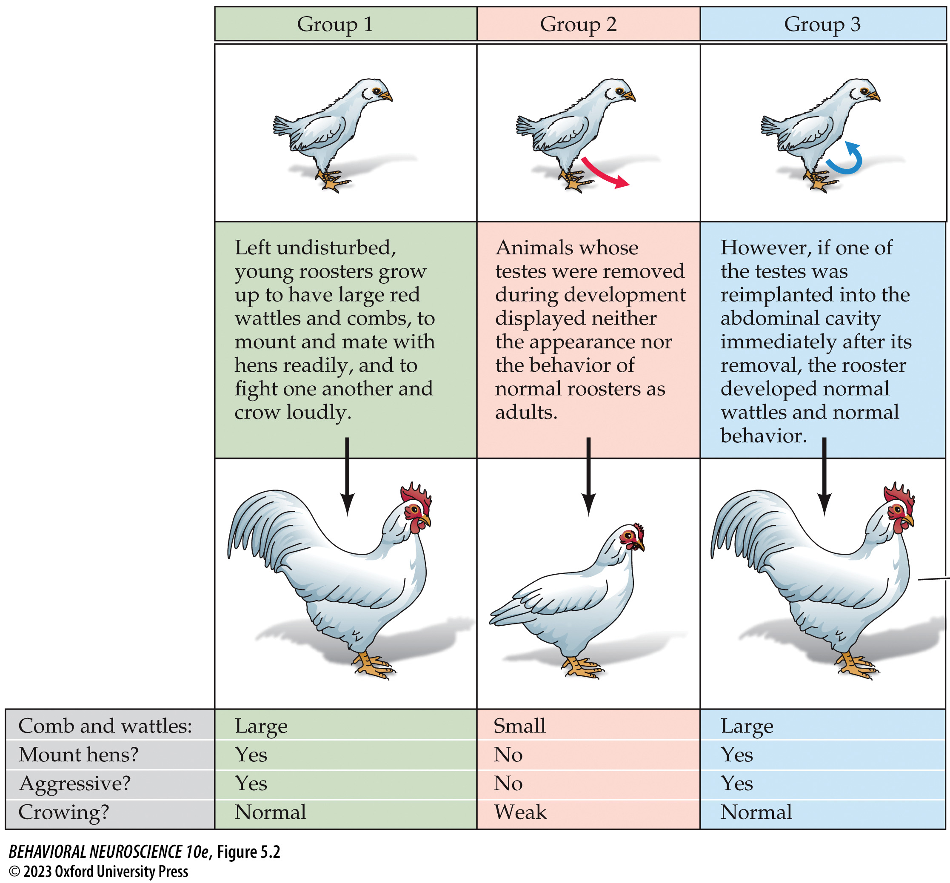
Hormone Systems
Berthold, 1849
Research Question: Does the presence of testes affect the behavior and physical traits of male roosters?
Method: Physical and behavioural traits of roosters were analyzed in terms of the status of their testes
Manipulation: Surgical
Healthy controls
Castrated only
Castrated with transplanted testes

Slide 39
Hormone Systems
Berthold, 1849
Dependent Variable
Physical: Comb and wattles
Behavioural: Mounting, aggression, crowing
Results
Physical: Castrated roosters developed small comb and wattles
Behavioural: Castrated roosters did not show typical mounting, aggression, or crowing
Transplanted group showed normal physical and behavioural characteristics
Even when from another rooster

Slide 40
Hormone Systems
Berthold, 1849
Conclusion
Testes are important for producing typical physical and behavioural characteristics in roosters
The transplantation of testes was sufficient to produce these characteristics
Thus, it was not the surgical procedure itself that caused the change in characteristics

Slide 41
Hormone Systems
Ovaries
Site of egg maturation and ovulation (egg release)
Hormones: Estrogen and progesterone
Steroid hormones
Estrogen
Determines puberty and sexual development
Breast growth, hair growth, menstrual cycle
Some evidence suggests improved cognitive functioning
May also protect brain from stress and stroke

Slide 42
Hormone Systems
Ovaries
Progesterone
Thickens endometrium (lining of uterus) to support implantation and growth of a fertilized egg
Helps prevent ovulation and uterine contractions during pregnancy
Prepares the body for breastfeeding

Slide 43
Hormone Systems
Mammary Glands
Hormone: None
Function: Lactation and breast development during pregnancy
Tissues and Organs Bones
Hormone: None
Function: Growth and maintenance of cells and tissues

Slide 44
Hormone Systems
Pineal Gland
Hormone: Melatonin
Amine hormone
Function:
Involved in biological rhythms (e.g., circadian rhythms)
Tracks day length and seasonal changes
Promotes sleep onset and regulates sleep–wake cycles
Influences breeding patterns in seasonal breeding mammals
Not stimulated by the hypothalamus and pituitary gland

Slide 45
Structure | Produced Hormone(s) | Type of Hormone | General Function
Posterior Pituitary Gland | Vasopressin | Peptide hormone | Water retention and blood pressure regulation
Posterior Pituitary Gland | Oxytocin | Peptide hormone | Reproduction, parental bonding, and social behaviours
Adrenal Cortex | Glucocorticoids (e.g., cortisol), Mineralocorticoids (e.g., aldosterone) | Steroid hormones | Stress response, energy regulation, blood pressure and fluid balance
Adrenal Medulla | Epinephrine, Norepinephrine | Amine hormones | Fight-or-flight response
Thyroid Gland | Thyroid hormones (T3/T4) | Amine hormones | Regulation of metabolism, growth, development, and physiological activity
Testes | Testosterone | Steroid hormone | Sperm production, sexual development, reproductive behaviour
Ovaries | Estrogen, Progesterone | Steroid hormones | Egg maturation, reproductive function, pregnancy support
Mammary Glands | None | — | Lactation and breast development
Bones and Other Tissues | None | — | Growth and maintenance of cells and tissues
Pineal Gland | Melatonin | Amine hormone | Regulation of circadian and seasonal rhythms

Slide 46
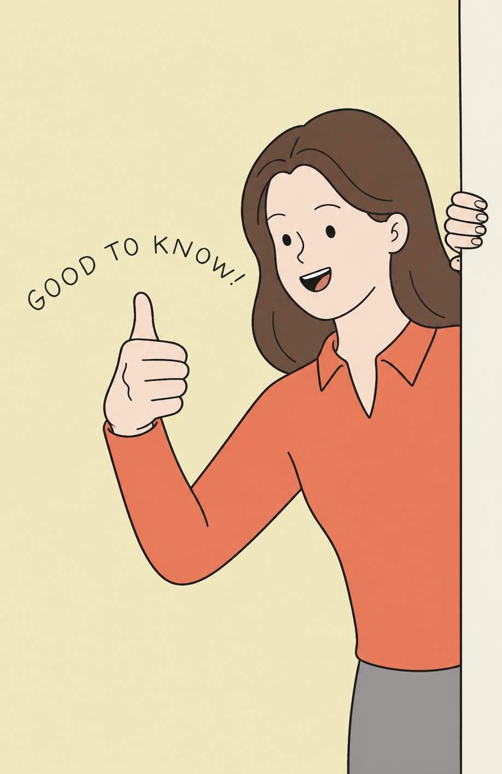
Testable Figures
Slides 11-14
Slide 33
All figures corresponding to the results of a study are testable material.

